Slide 1

LONGS AND SHORTS, STOCK SELECTION AND WEIGHTING
Using Data Analytics and Statistical Techniques
MATH 377, Izuchukwu Egonu

Slide 2
Overview
🧭
This project integrates a factor-based trading strategy with portfolio optimization techniques.
First, a long-short equity portfolio is constructed using price momentum factors derived from Berry Cox’s alpha generators. Assets are selected from within the S&P500 ETF equivalent universe and ranked monthly using z-scores based on their momentum characteristics. This calculation will decide what assets will be placed within long and short baskets, respectively.
Next, the portfolio is dynamically weighted using two optimization approaches:
Sharpe Ratio Maximization – Identifying the portfolio weights along the efficient frontier that maximize risk-adjusted returns using Monte Carlo simulation.
Volatility Minimization – Finding the weight configuration that achieves the lowest portfolio variance.
Both weighting schemes are recalculated monthly to account for changes in asset selection and market dynamics. A comprehensive backtest over a 5-year horizon evaluates the performance of the strategy, comparing cumulative returns, monthly returns, and basket-level returns against the benchmark ETF.
By combining alpha signal generation with rigorous portfolio optimization, this project demonstrates how systematic strategies can be enhanced through quantitative methods grounded in modern portfolio theory.

Slide 3
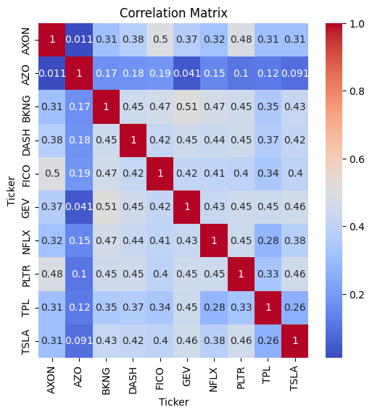
Meet the Data
📊
 | Mean | Variance
PLTR | 0.007109 | 0.001985
TSLA | 0.003458 | 0.002076
BKNG | 0.001603 | 0.000329
TPL | 0.003884 | 0.001159
GEV | 0.004565 | 0.001288
NFLX | 0.002562 | 0.000440
AXON | 0.003578 | 0.001156
AZO | 0.000716 | 0.000174
FICO | 0.002211 | 0.000442
DASH | 0.001649 | 0.000617

Slide 4
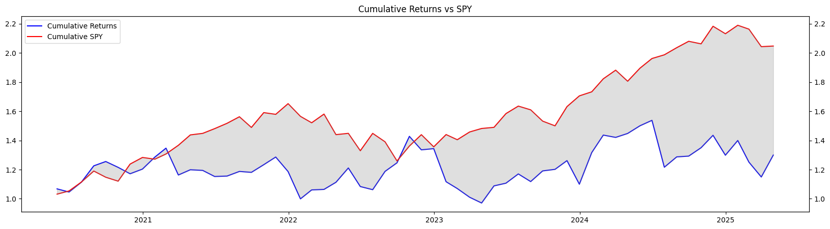
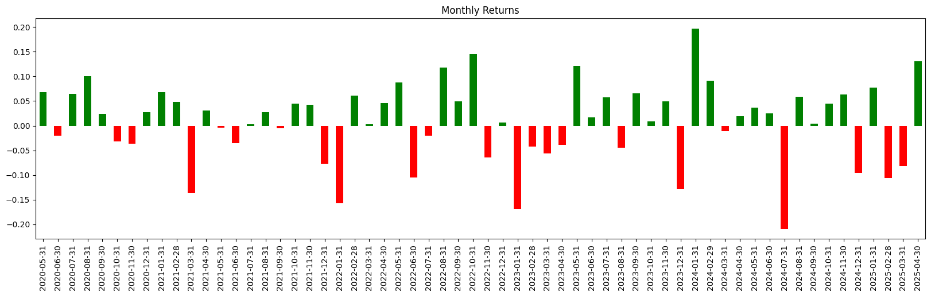
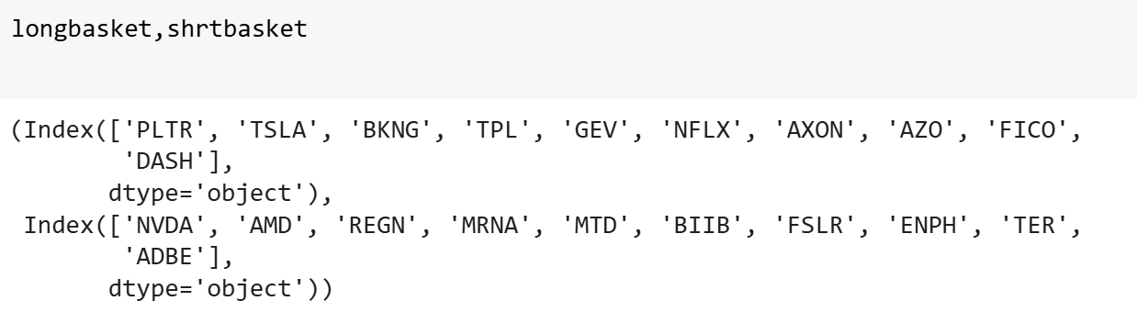
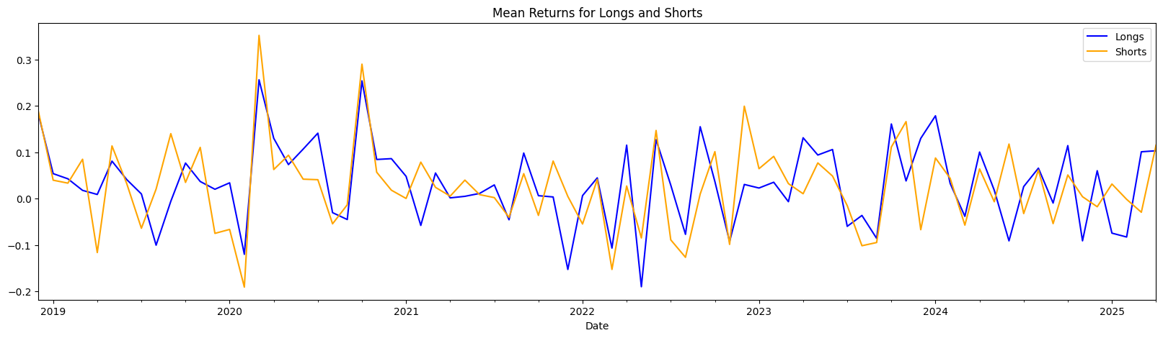
Long & Short Basket Results
📈
📉
The long basket contains high-momentum stocks such as TSLA, NFLX, and BKNG, which the model predicts will outperform based on recent price trends. The short basket includes lower-momentum stocks like NVDA, ADBE, and MRNA, expected to underperform. This long-short strategy aims to capture the relative performance between the strongest and weakest assets while reducing overall market exposure.

Slide 5
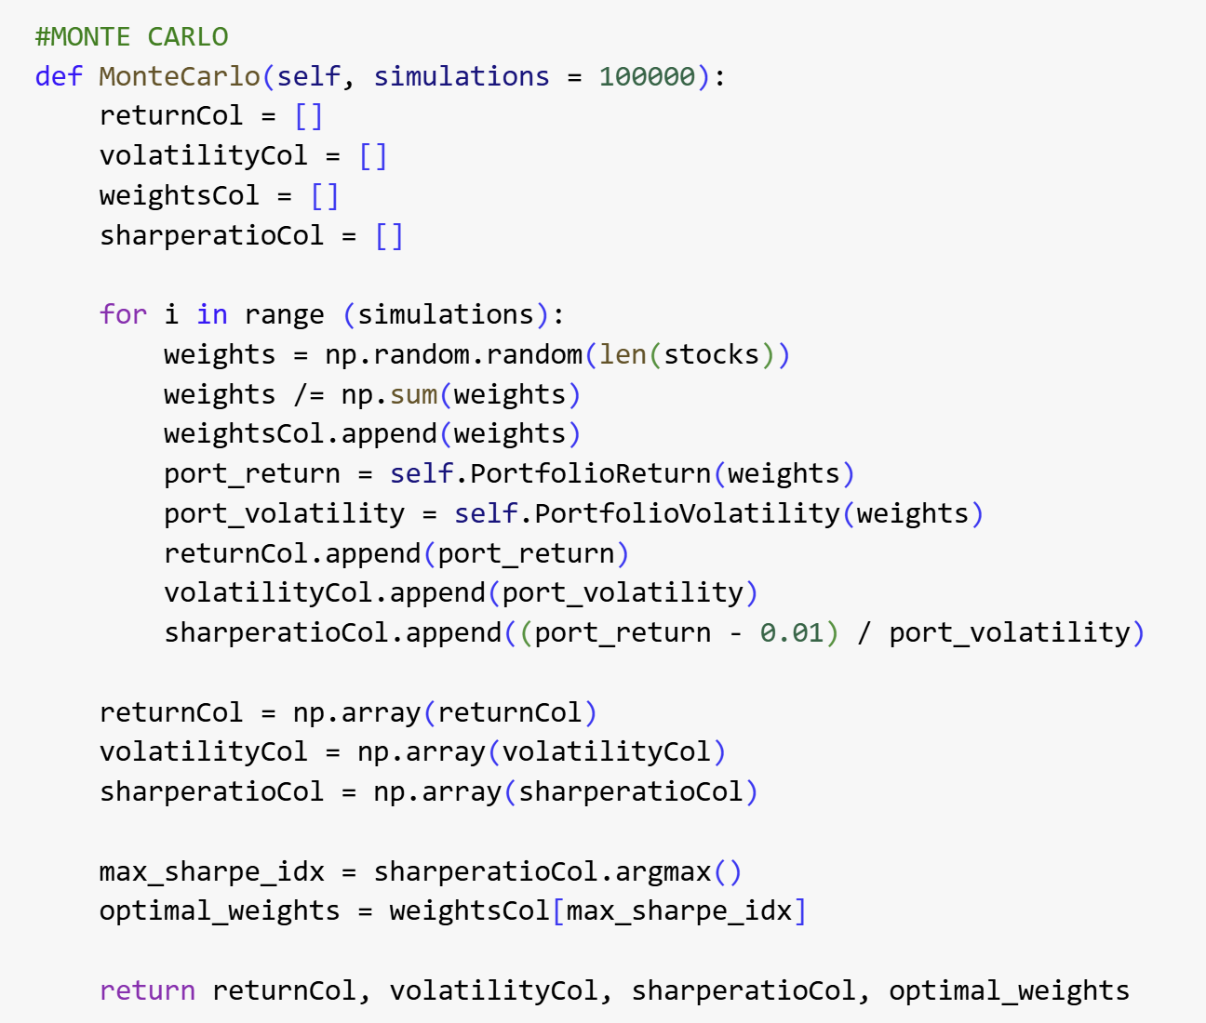
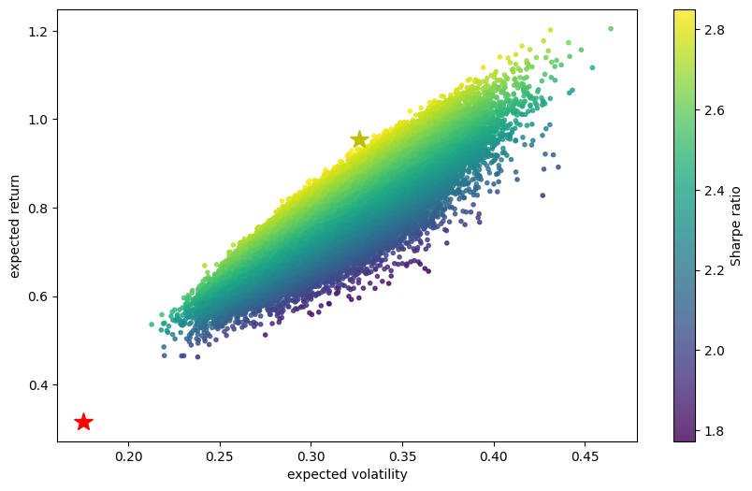
🧩
Monte Carlo Method and Efficient Frontier
The Monte Carlo method is a computational technique that uses random sampling to solve problems that might be deterministic in principle. The Monte Carlo simulation was used to generate a large number of random portfolio weightings across the selected tickers.
For each simulated portfolio the following were computed:
Expected return: Weighted sum of individual asset returns
Volatility: Based on the covariance matrix of asset returns
Sharpe Ratio: A measure of risk-adjusted return

Slide 6
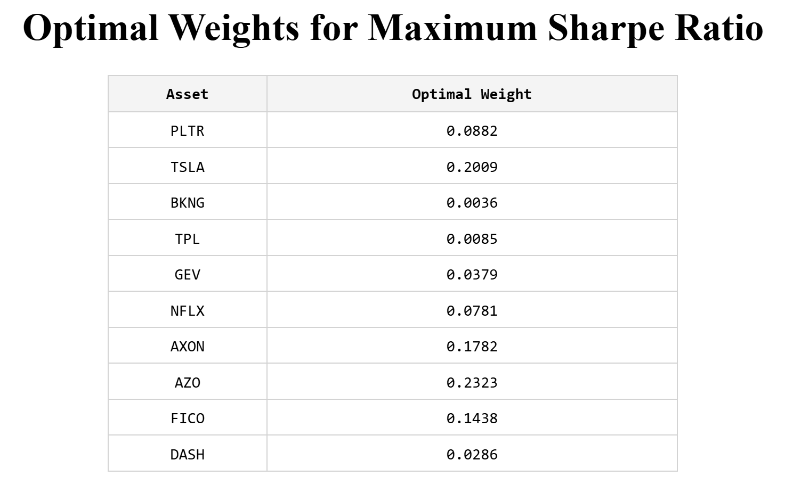
💼
DASHBOARD, AND EXPASION
🌍
Next Steps
To expand this project, I would incorporate additional asset classes such as bonds, ETFs, or international equities to enhance diversification. I could also implement dynamic rebalancing strategies and evaluate portfolio performance over different market regimes. Incorporating factor models (e.g., Fama-French), transaction costs, and ESG constraints would bring the optimization closer to real-world applications.

